Slide 1

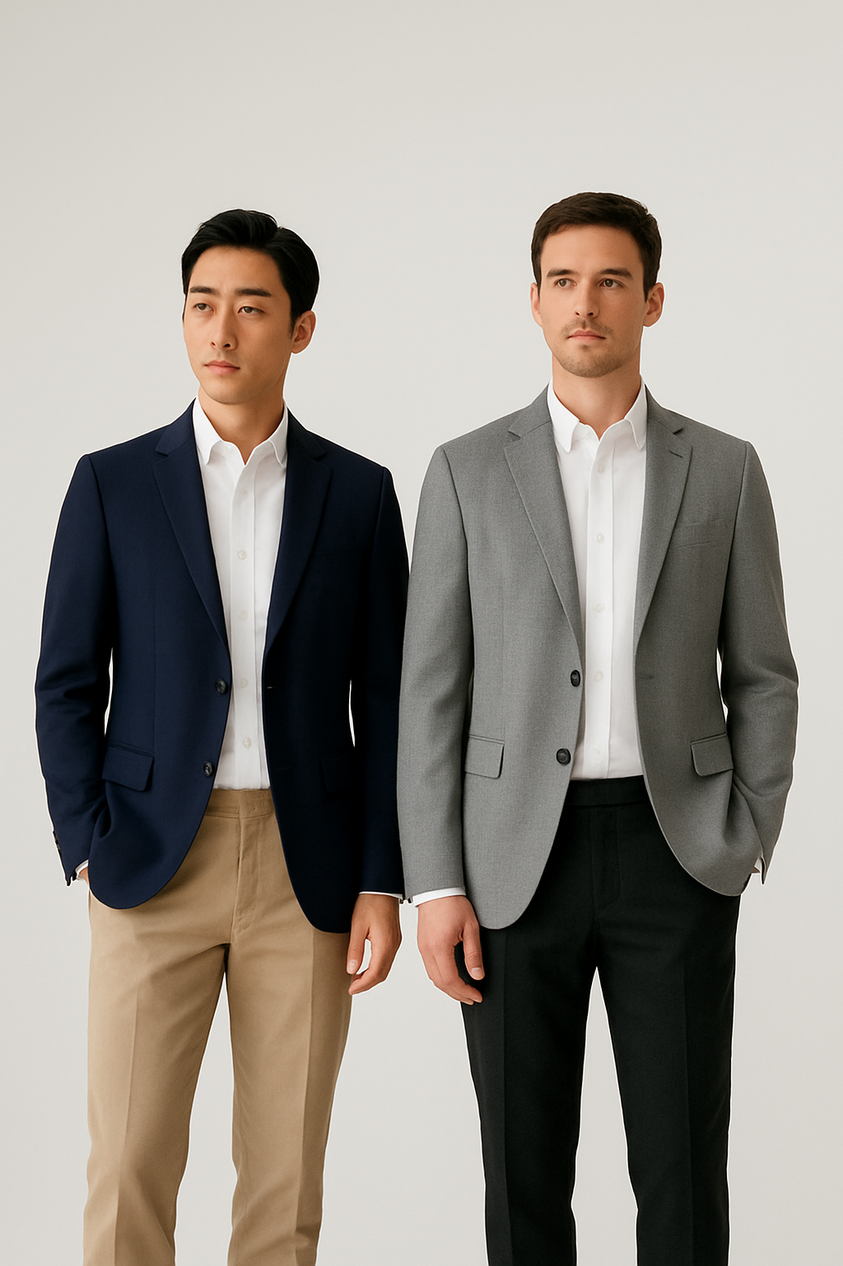



Online Men’s Fashion Store
Redefining Fashion with Purpose
Presented By
Rokunuzzaman Topu
ID-232002280
Md Rafiuddin Khan Rafi
ID-232002152
Presented To,
Feroza Naznin
Lecturer
Dept. Of CSE

Slide 2
Table of Content
35,000+ loyal returning customers
Featured in leading sustainable fashion publications and platforms
12,000 units sold in Q2 alone
01
02
03
04
05
Introduction
Objectives & Features
Technologies Used
How The Website Work
Future Improvement

Slide 3

Introduction
This project is an online men’s fashion shopping website.
Customers can browse products, add them to cart, and place orders.
The website helps users buy clothes easily without visiting a physical store.

Slide 4
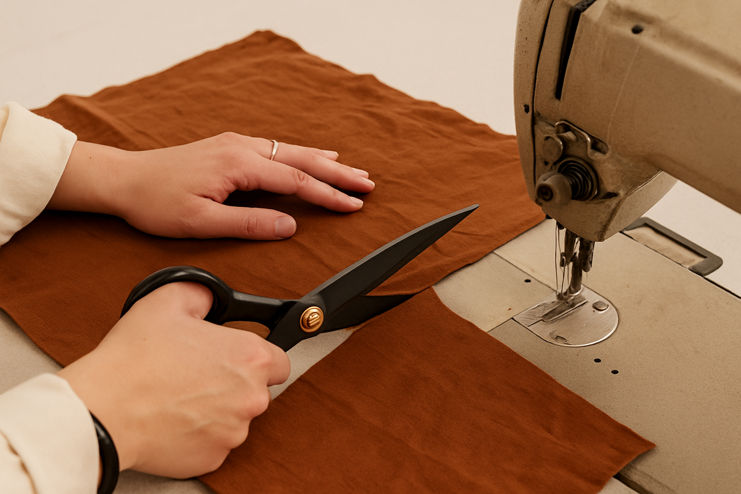


Objectives & Features
Objectives
Create an online platform for men’s fashion
Provide easy and fast shopping experience
Features
User Login & Registration
Product Categories (T-shirt, Hoodie, Drop Shoulder)
Order Tracking

Slide 5
Technologies we used
Layer | Technology
Frontend | HTML, CSS, JavaScript
Dynamic Communication | JavaScript (AJAX)
Backend | Php
Data Format | XML
Server | XAMPP

Slide 6
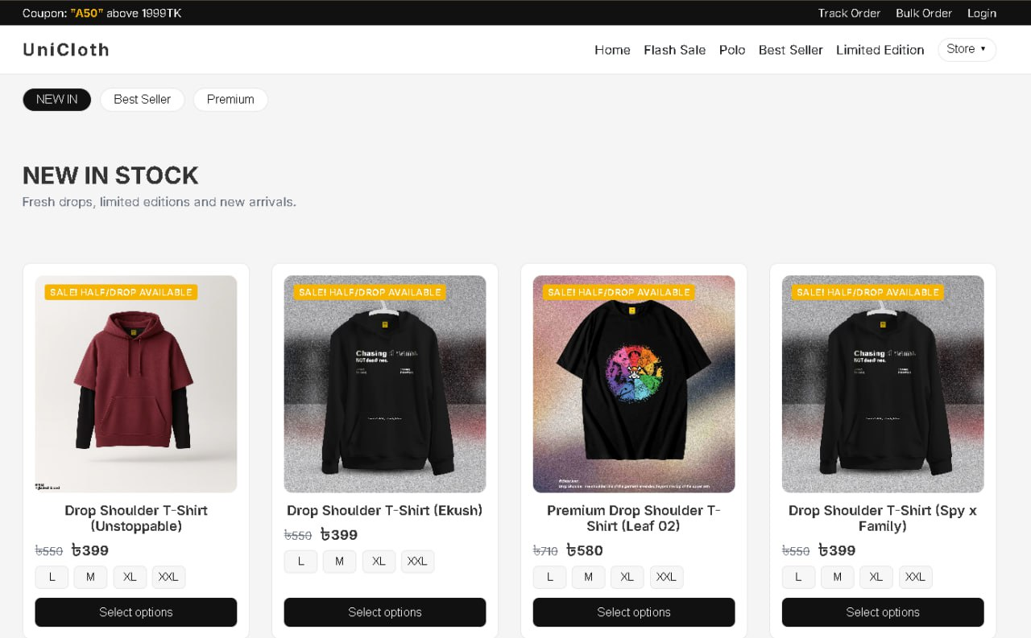
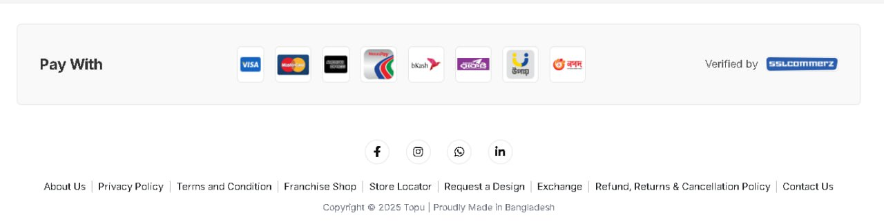
How The Website Work
Home page
Home Page

Slide 7
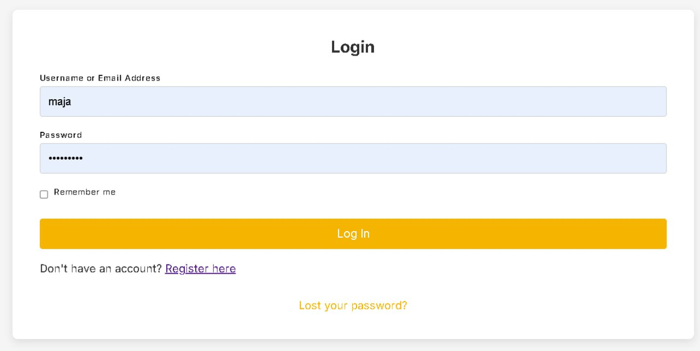
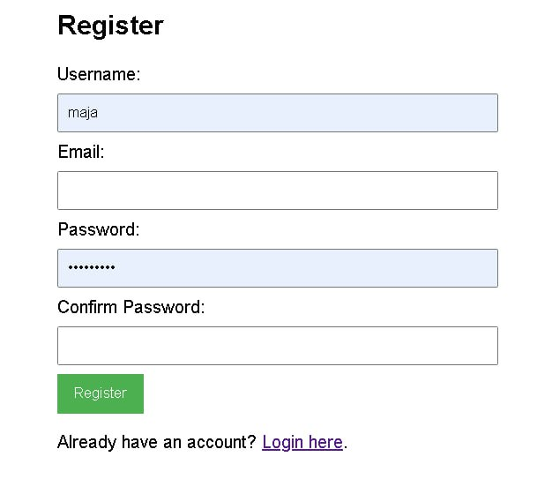
How The Website Work
Login
Register

Slide 8
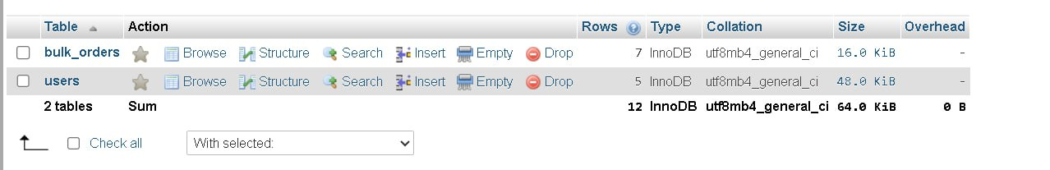
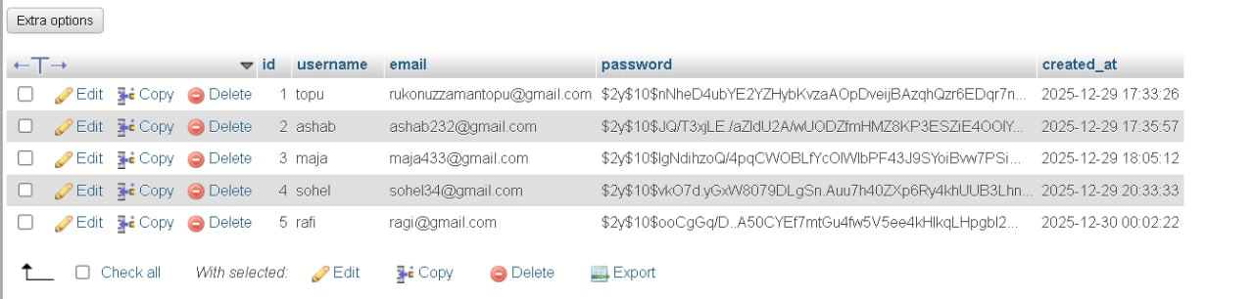
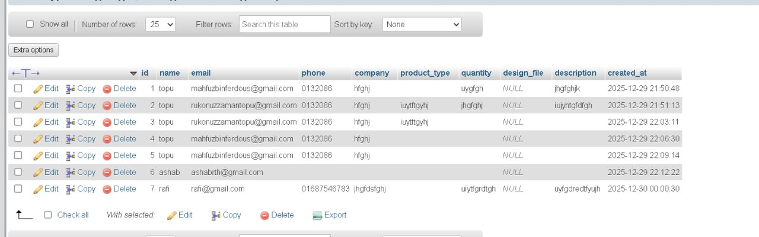
How The Website Work
Users Information Database

Slide 9
How The Website Work
Bulk Order Database

Slide 10
Future Improvement
Mobile app
AI based product recommendation
Live order tracking

Slide 11
Thank You

